Slide 1

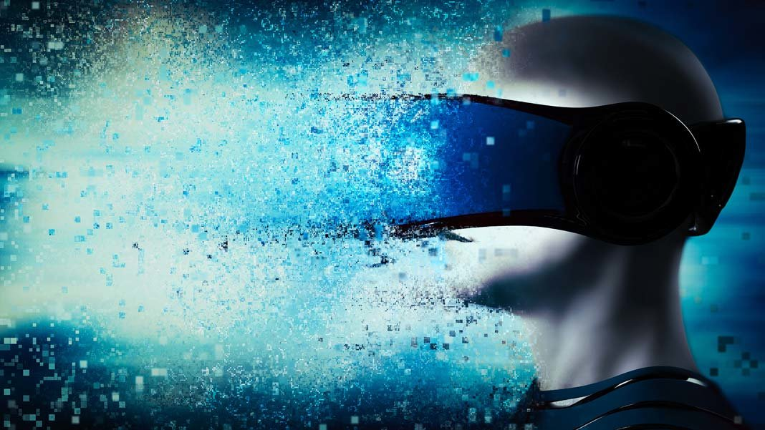
MOTION SICKNESS
and what the F. do we do about it?

Slide 2

“Motion sickness is a sensation of wooziness. It usually occurs when you’re traveling by car, boat, plane, or train. Some people learn early in their lives that they’re prone to the condition.”
- www.healthline.com
Notes:
What is motion sickness?
“Motion sickness is a sensation of wooziness. It usually occurs when you’re traveling by car, boat, plane, or train. Some people learn early in their lives that they’re prone to the condition.”

Slide 3
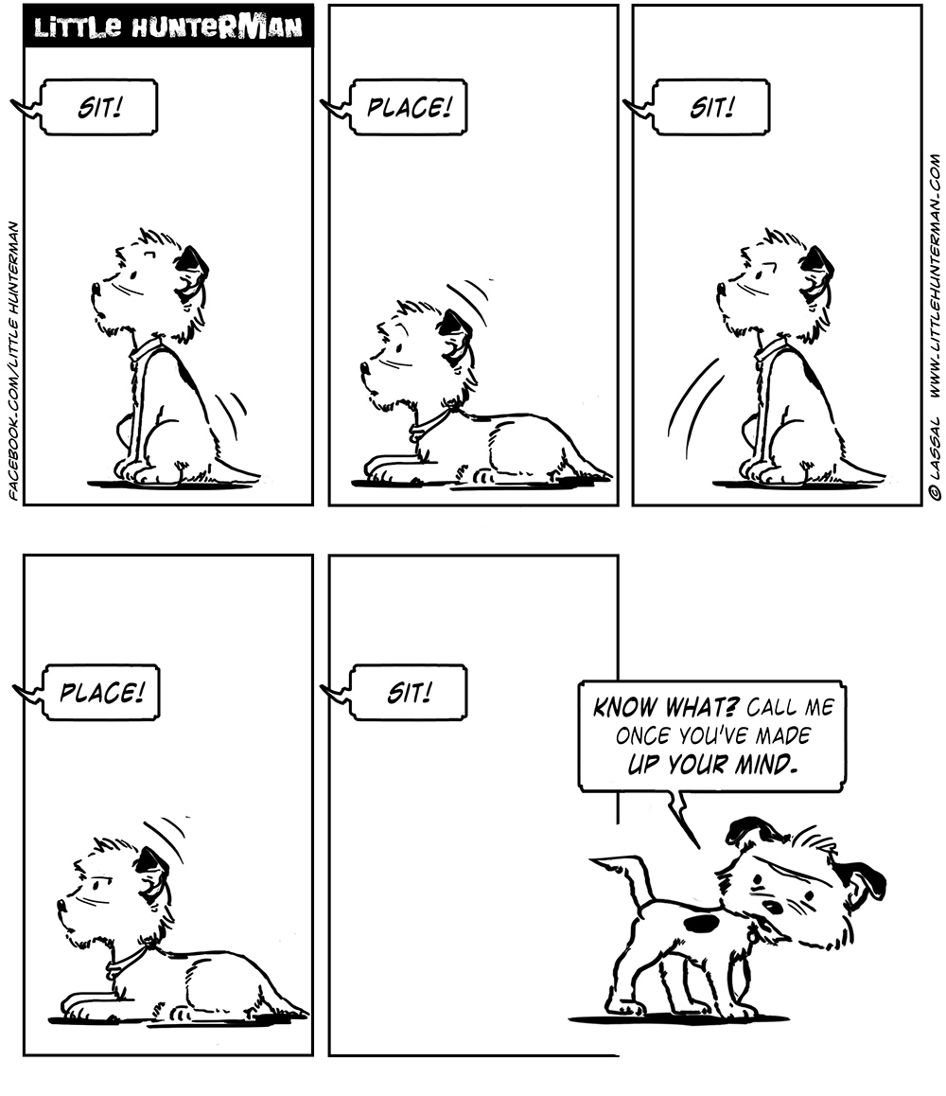
Mixed
Messages
Notes:
What causes Motion Sickness?
You maintain balance with the help of signals sent by many parts of the body — for instance, your eyes and inner ears. Other sensory receptors in your legs and feet let your nervous system know what parts of your body are touching the ground.
Conflicting signals can cause motion sickness. For example, when you’re on an airplane you can’t see turbulence, but your body can feel it. The resulting confusion can cause nausea or even vomiting.

Slide 4

The inner ear in particular is important. As it helps control your sense of balance.
Notes:
The inner ear in particular is important in this regard, as it helps control your sense of balance.
They are part of a network called the vestibular system.
This system includes three pairs of semicircular canals and two sacs, called the saccule and the utricle. They send information about what’s going on around you to the brain.
The semicircular canals hold a fluid that moves with the turns of your head. The saccule and utricle are sensitive to gravity. They tell the brain whether you’re standing up or lying down.

Slide 5
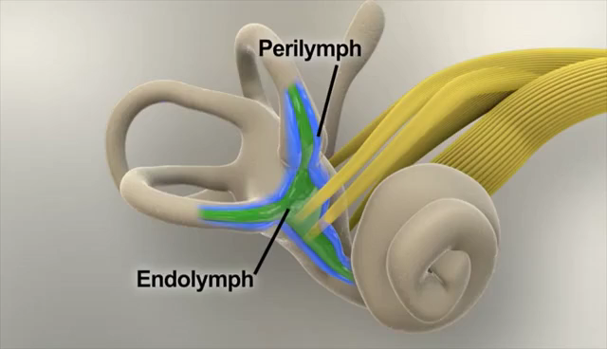
Notes:
The inner ear in particular is important in this regard, as it helps control your sense of balance.
They are part of a network called the vestibular system.
This system includes three pairs of semicircular canals and two sacs, called the saccule and the utricle. They send information about what’s going on around you to the brain.
The semicircular canals hold a fluid that moves with the turns of your head. The saccule and utricle are sensitive to gravity. They tell the brain whether you’re standing up or lying down.

Slide 6

Some toxins, when ingested, can mess with the vestibular system. And if you’ve got some poison in you, it would be good to throw it up…
Notes:
The inner ear in particular is important in this regard, as it helps control your sense of balance.
They are part of a network called the vestibular system.
This system includes three pairs of semicircular canals and two sacs, called the saccule and the utricle. They send information about what’s going on around you to the brain.
The semicircular canals hold a fluid that moves with the turns of your head. The saccule and utricle are sensitive to gravity. They tell the brain whether you’re standing up or lying down.

Slide 7

MOTION
SICKNESS
Notes:
Sickness in virtual reality exists already for quite a while. I found quite a few articles 20 years old and older describing the effects.
The name however has been evolving throughout the years. There are reports describing ‘simulator sickness’, mostly referring to army simulators.
The one I like the most is ‘cyber sickness’.
Also virtual reality sickness is a thing.
Although there are likely differences between these categories, I think most of these differences relate to the extent of the symptom. All of them relate to the core idea of motion sickness, being a conflict in signals.

Slide 8

GIMME MORE
References:
“How the Inner Ear Balance System Works” - https://youtu.be/YMIMvBa8XGs
https://www.healthline.com/health/motion-sickness
https://www.webmd.com/cold-and-flu/ear-infection/motion-sickness#1
https://www.theatlantic.com/health/archive/2015/02/the-mysterious-science-of-motion-sickness/385469/
https://uploadvr.com/7-ways-overcome-vr-motion-sickness/
https://journals.sagepub.com/doi/pdf/10.1177/107118139704100292
https://dl.acm.org/citation.cfm?id=333344
https://www.frontiersin.org/articles/10.3389/fpsyg.2018.02132/full
Notes:
If you want more…

